Slide 1
CEF 44O: INTERNET PROGRAMMING (J2EE) AND MOBILE PROGRAMMING
PRESENTED BY
AJAMAH GODLOVE NKEMEJAH FE21A129
AMABO JOSHUA NGWA FE21A135
MBACHAM LOANA NING FE21A228
NGOUNG TASSA ALAIN SHIRESS FE21A262
NYUYSEVER BORIS DINNYUY FE21A295
TASK 5

Slide 2
TABLE OF CONTENTS
01
02
03
INTRODUCTION
UI DESIGN
CONCLUSION

Slide 3
01. INTRODUCTION
A. FOREWORD
User interface (UI) design is crucial in shaping user experiences and the success of software applications. This report will walk you through our project. It covers the implementation stage, turning design concepts into interactive experiences, and offers insights for designers, developers, and stakeholders.
The report aims to advance user-centered design practices, creating attractive and functional digital products, and inspire the application of these principles to enhance user satisfaction, engagement, and productivity.

Slide 4
B. RELATION TO SCOPE
In a fingerprint attendance recording application, the user interface (UI) design and implementation phases are critical to ensuring a seamless, efficient, and user-friendly experience.
The success of such an application relies heavily on intuitive design and robust implementation, making these phases crucial to its overall functionality and user adoption. Below are a few steps used in designing it.

Slide 5

02. UI (USER INTERFACE) DESIGN
Figma was used to design our UI. This entailed designing the various login pages’ interfaces for most tasks to be carried out. The different pages are as follows:

Slide 6
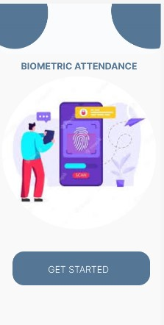
A. WELCOME PAGE
This is the first page that appears when the application is opened. It displays a welcome message and a "Get Started" button. Clicking on the button takes the user to the login page.

Slide 7
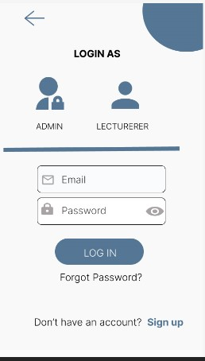
B. LOGIN PAGE
This is the first page that appears after the welcome page. On this page, users must enter their email address and password. They are then prompted to choose whether they are logging in as an admin or a lecturer. The following occur based on the user's choice

Slide 8
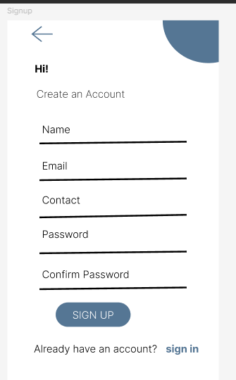
C. SIGN UP PAGE
This page is for new lecturers who don't have an account yet. To access this page, the lecturer should click on the "Don't have an account yet? Sign up" option on the page.

Slide 9
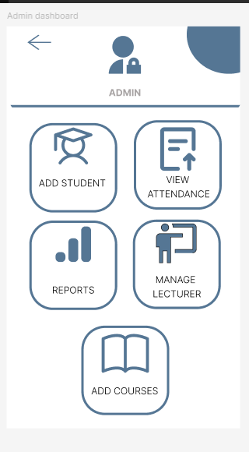
D. ADMIN DASHBOARD
This account opens if an admin account with the entered credentials exists. The admin dashboard provides access to various functionalities such as adding students, viewing attendance, managing lecturers, generating reports, and adding courses. The following pages and actions are available based on the selected option:

Slide 10
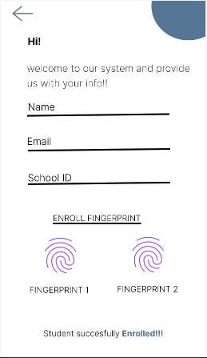
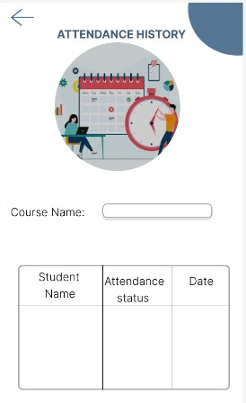
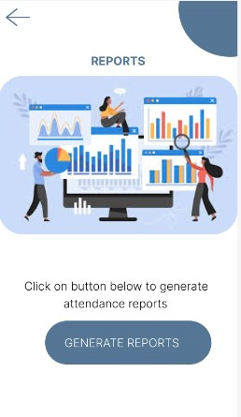

Slide 11
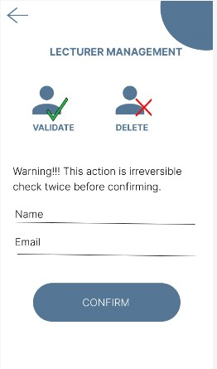
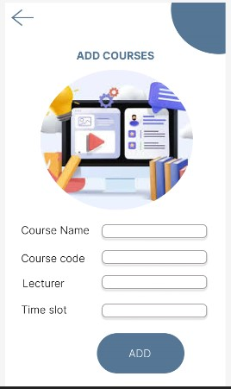

Slide 12
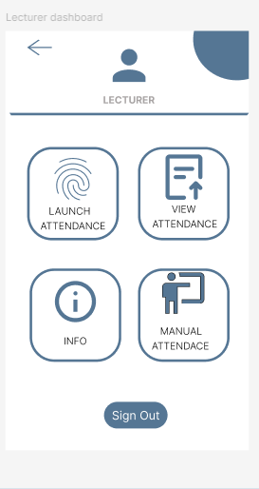
E. LECTURER’S DASHBOARD
Lecturers can access the following pages: launch attendance, view attendance, info, manage attendance, and sign out. Each page is detailed below:

Slide 13
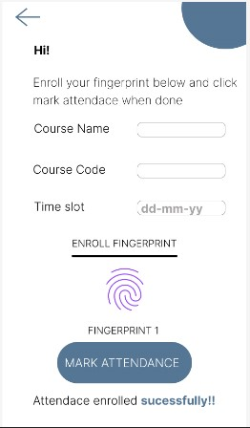
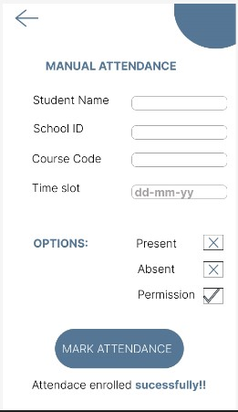
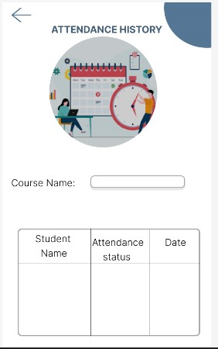

Slide 14
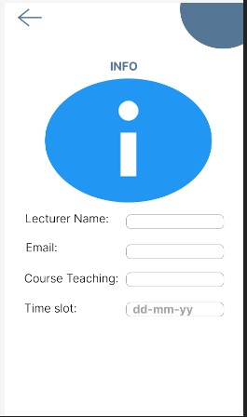

Slide 15
3. CONCLUSION
This design leverages modern design principles and best practices to create a cohesive and aesthetically pleasing user experience. It is responsive and adaptable, ensuring consistent performance across various devices, including tablets and smartphones.

Slide 16
THANKS FOR YOUR KEEN ATTENTION

